Slide 1

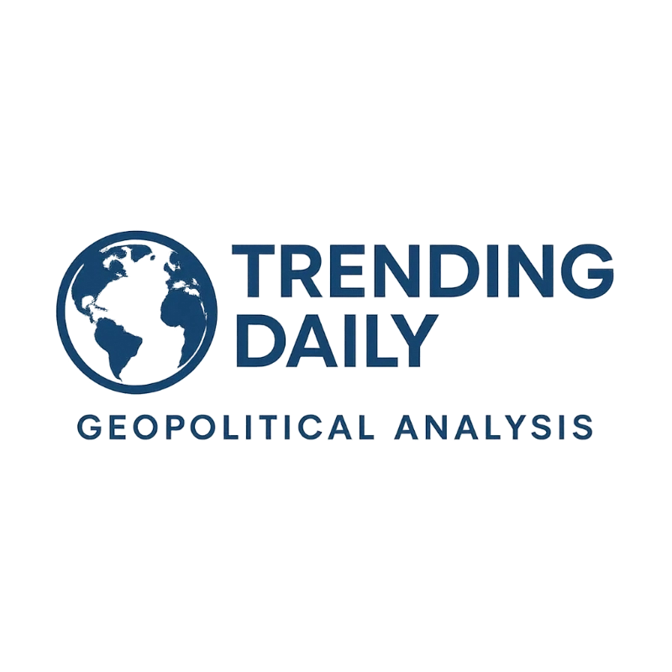
TRENDING DAILY INSIGHTS
Premium Sponsorship Opportunities
AI-Powered Geopolitical Analysis • Premium Audience • Proven Results

Slide 2

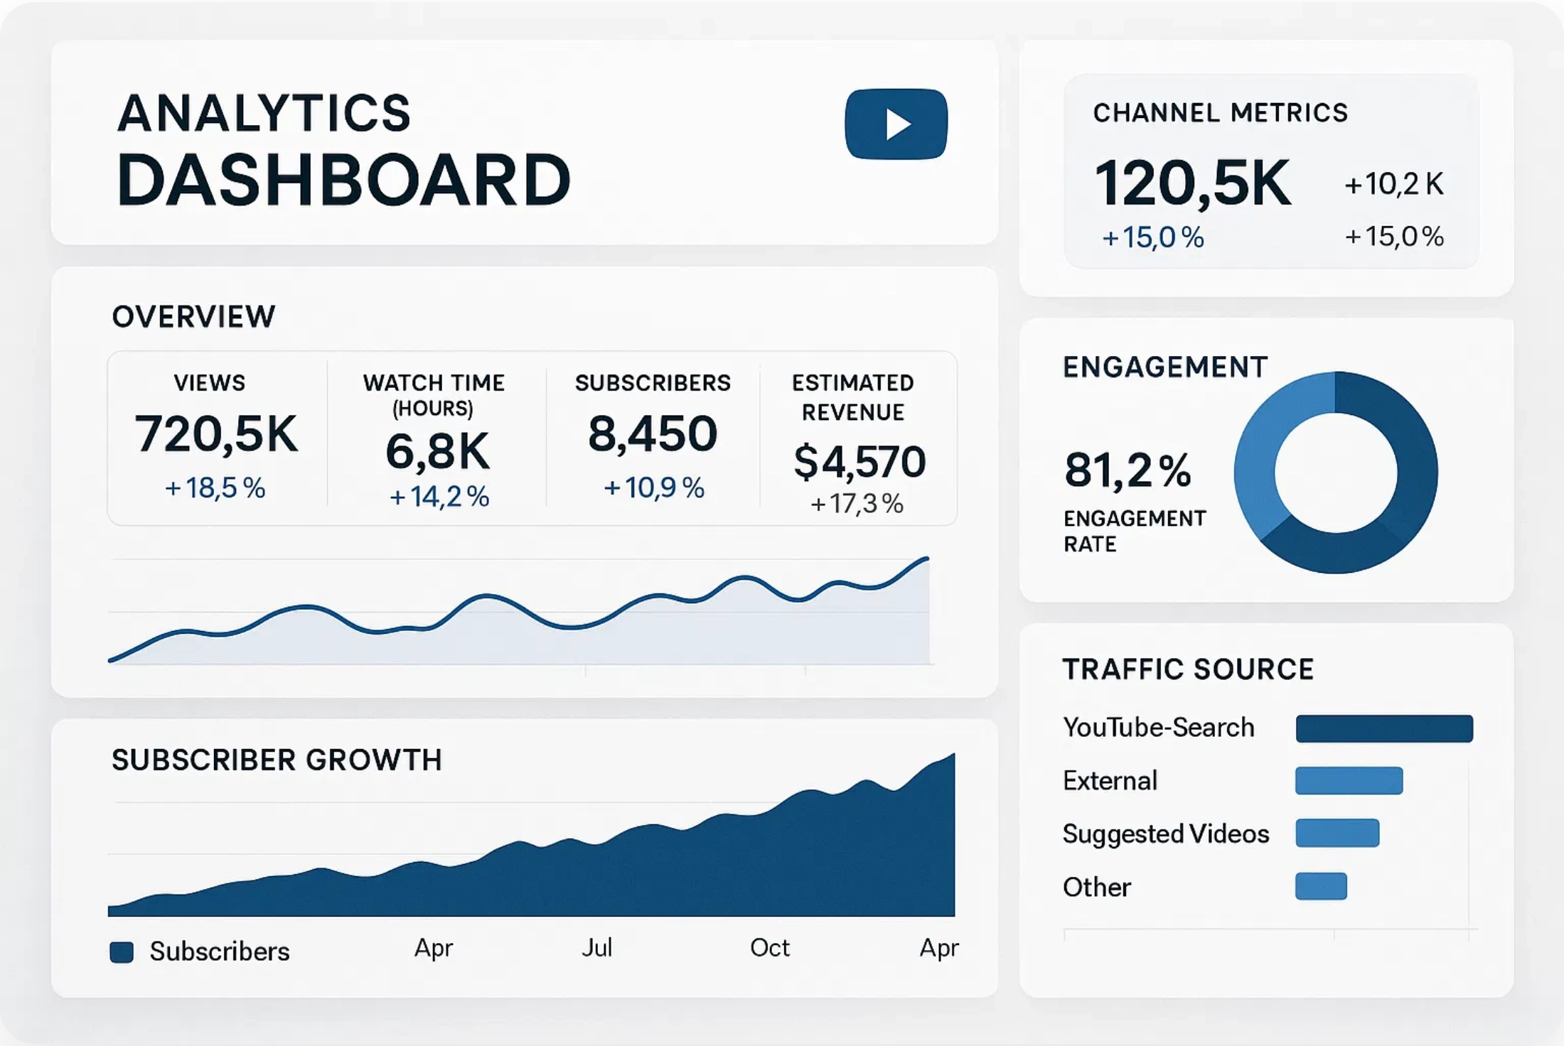




Channel Overview & Unique Value Proposition
AI-Powered Geopolitical Analysis with Premium Audience Engagement
AI-Generated Consistency
Daily content with 100% reliability. No delays, no gaps. Your brand message delivered consistently every day.
Geopolitical Expertise
Deep analysis of global events and economic implications. Perfect alignment with finance and business audiences.
Premium Audience Quality
High-income, educated professionals in finance and business sectors. Perfect target demographic for B2B sponsors.
Scalable Integration
2,255
75K+
8.2%
Daily
Seamless sponsor integration through AI optimization. Natural placement and performance optimization included.
Subscribers
Monthly Views
Engagement Rate
Content Schedule

Slide 3

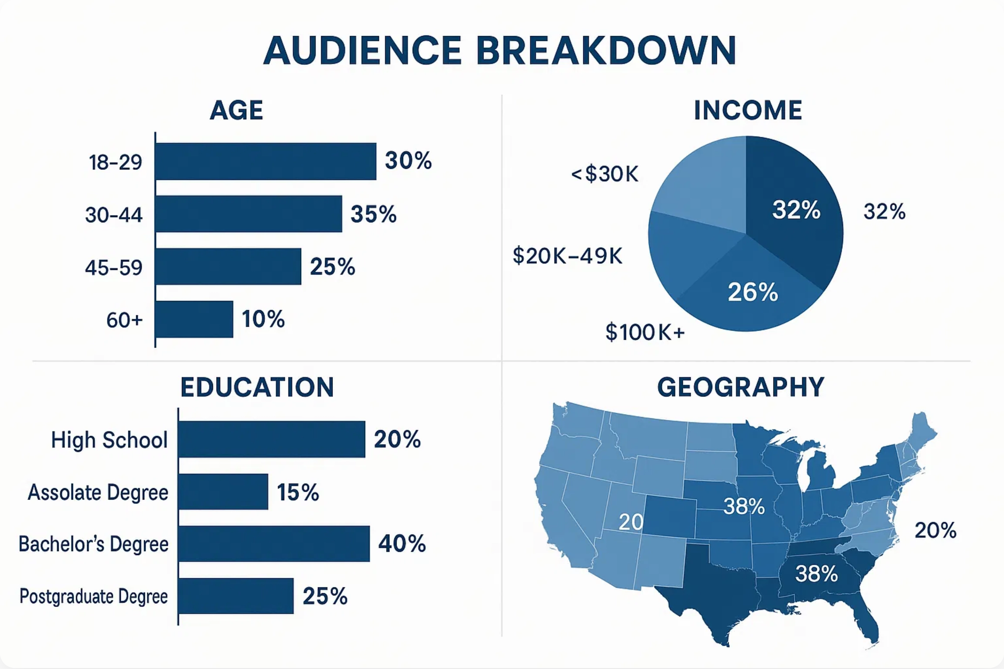



Premium Audience Demographics
High-Value Audience Profile for Maximum Sponsor ROI
High Income Professionals
Highly Educated Viewers
Decision Makers
58% of our audience earns $100K+ annually, with 32% earning over $150K. This high-income demographic has significant purchasing power.
65% hold bachelor's degrees or higher, with 25% having postgraduate education. This educated audience values in-depth analysis.
42% hold management positions or higher, with 18% at executive level. Your brand message reaches professionals with decision-making authority.

Slide 4


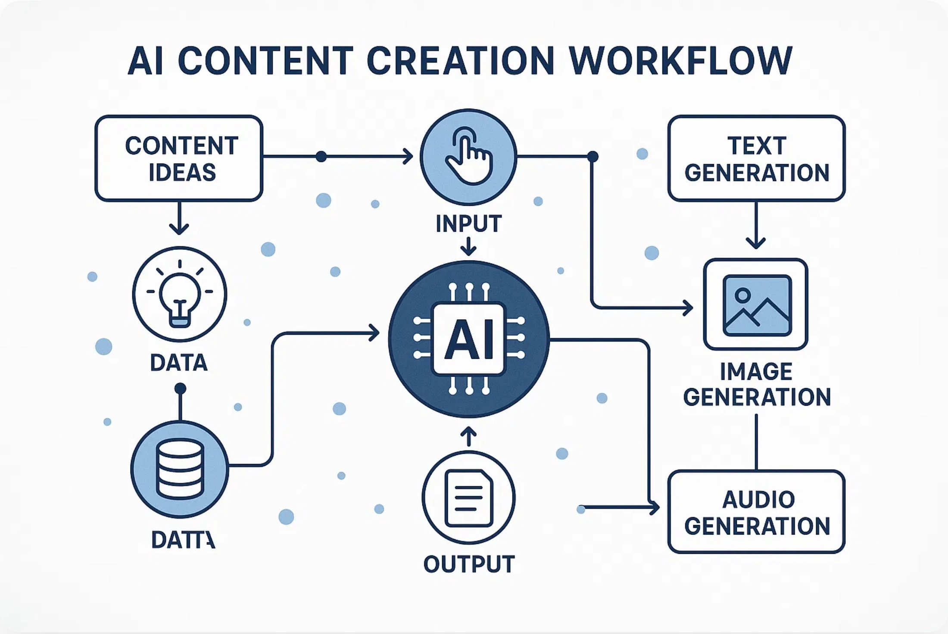







AI-Generated Content Advantage
How Our Technology Creates Superior Sponsorship Value
Unmatched Consistency
Daily content delivery with 100% reliability. Our AI system ensures your sponsorship message reaches audiences every single day without fail, maximizing exposure and brand recognition.
Data-Driven Analysis
Content created using real-time data from thousands of sources. Our AI analyzes geopolitical events with unprecedented depth, attracting highly engaged viewers seeking quality insights.
Performance Optimization
Continuous improvement through machine learning. Our system analyzes viewer engagement and optimizes content in real-time, ensuring your sponsorship receives maximum visibility.
Sponsor Benefits
Precise Targeting
Consistent Delivery
Performance Tracking
Optimization
Seamless Integration
AI-powered sponsor integration feels natural and contextual. Your brand message becomes part of the content narrative, increasing audience receptivity and engagement with your offerings.

Slide 5




Sponsorship Packages & Pricing
Strategic Partnership Opportunities with Premium ROI
BRONZE
SILVER
GOLD
$1,500
$3,500
$7,000
per month
per month
per month
30-second mid-roll mention
60-second dedicated segment
90-second premium segment
Logo in video description
Logo in video thumbnail
Custom branded content
1 dedicated social media post
3 dedicated social media posts
5 dedicated social media posts
Monthly performance reports
Weekly performance reports
Real-time performance dashboard
30 videos per month
30 videos per month
30 videos per month
Basic audience insights
Advanced audience insights
Premium audience insights
Newsletter mention
Featured newsletter placement
Quarterly strategy consultation
Select Bronze
Select Silver
Select Gold
All packages include AI-optimized placement and performance tracking. Custom packages available upon request.

Slide 6












Sponsor Integration Examples
Seamless Brand Integration with AI-Generated Content
Intro Sponsor Mention
Mid-Roll Segment
"Today's geopolitical analysis of the Ukraine situation..."
"...which brings us to the financial implications..."
Presented by SecureVPN
Financial analysis powered by
TradingPlatform
Natural Integration:
Brief 5-10 second sponsor mention at the beginning of the
Contextual Placement:
30-60 second dedicated segment naturally integrated at a
video, positioned as the presenting sponsor of today's analysis.
relevant transition point in the content.
Lower Third Integration
Description & Resource Links
"The economic sanctions are expected to impact global markets..."
Today's analysis covers the latest developments in the Ukraine conflict and potential economic impacts.
For investment insights on these developments, visit InvestCorp.com
Resources:
•
TradingPlatform: Special offer for viewers
•
SecureVPN: Protect your data while researching
Subtle Branding:
Non-intrusive lower third graphic appearing during relevant content
Extended Engagement:
Prominent placement in video description with custom
sections for 15-20 seconds.
tracking links.
Natural Content Integration
AI-Optimized Placement
Performance Tracking
A/B Testing

Slide 7


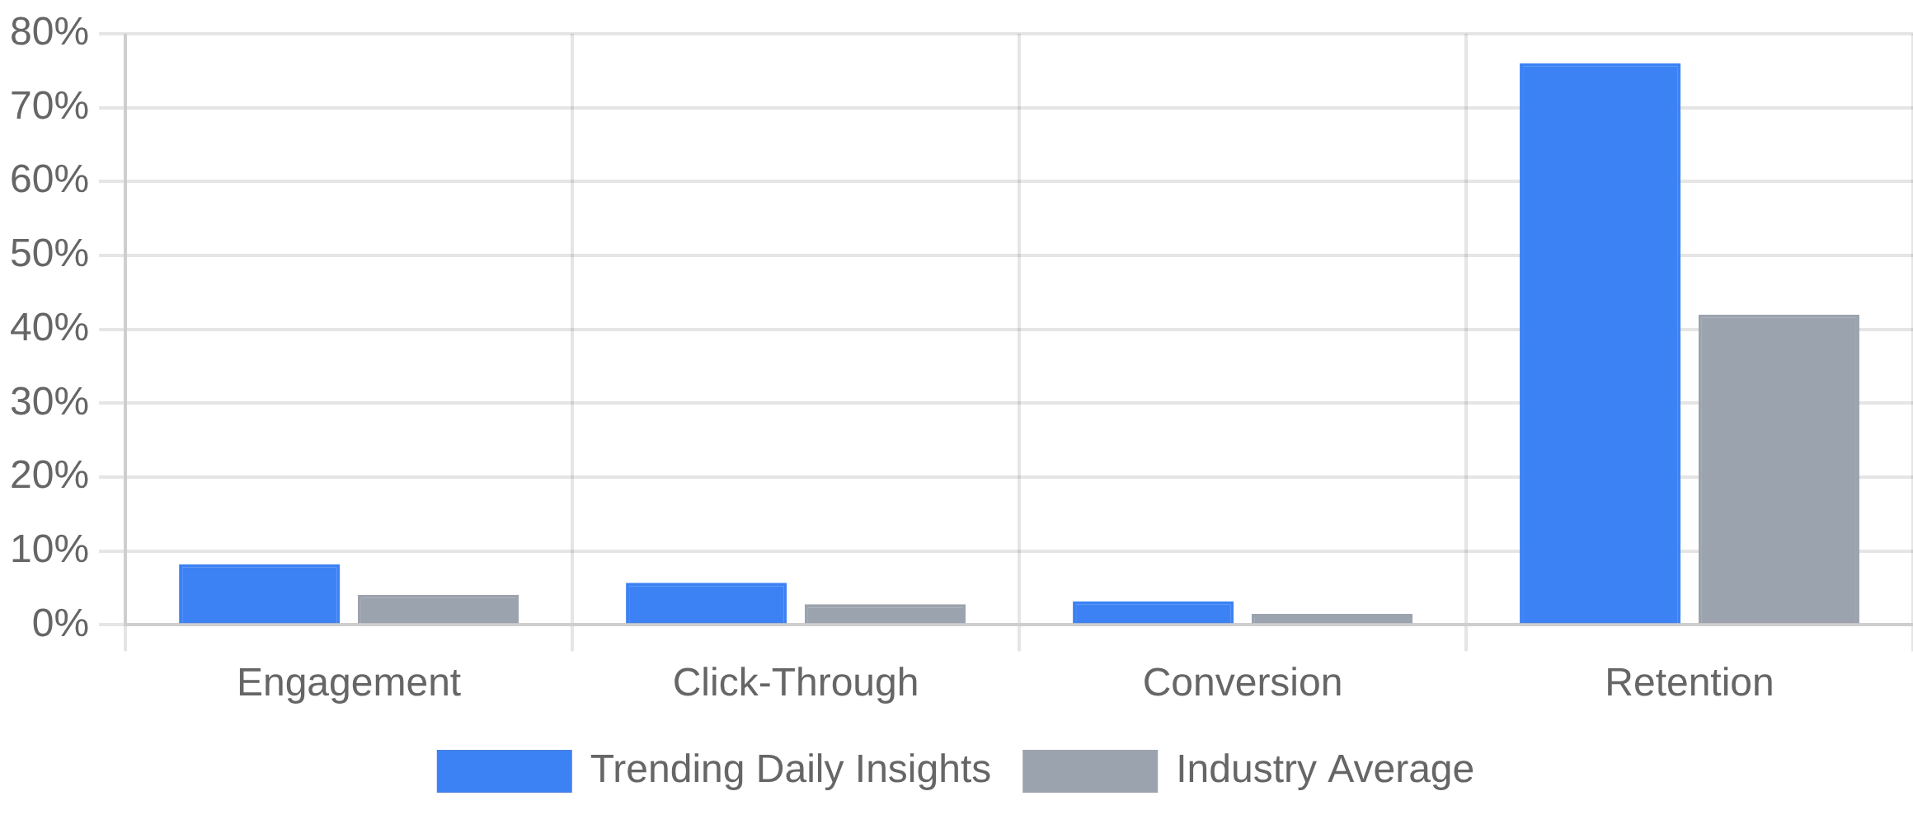


Performance Metrics & ROI
Measurable Results and Return on Investment for Sponsors
Sponsor Performance Metrics
ROI Calculation
2.1x
30 Days
Average ROI
Average Breakeven
$42
$89
Cost Per Acquisition
Average Customer Value
Bronze
Silver
Gold
1.8x ROI
2.3x ROI
2.7x ROI
Benchmark Comparison
Engagement Rate
8.2% vs 4.1% Industry Avg
Performance Guarantees
Engagement guarantee
Monthly reports
Click-Through Rate
5.7% vs 2.8% Industry Avg
A/B testing
Analytics dashboard
Conversion Rate
3.2% vs 1.5% Industry Avg
"Our sponsorship with Trending Daily Insights delivered a 2.4x return within the first
60 days. The audience quality exceeded our expectations."
— Financial Services Sponsor

Slide 8


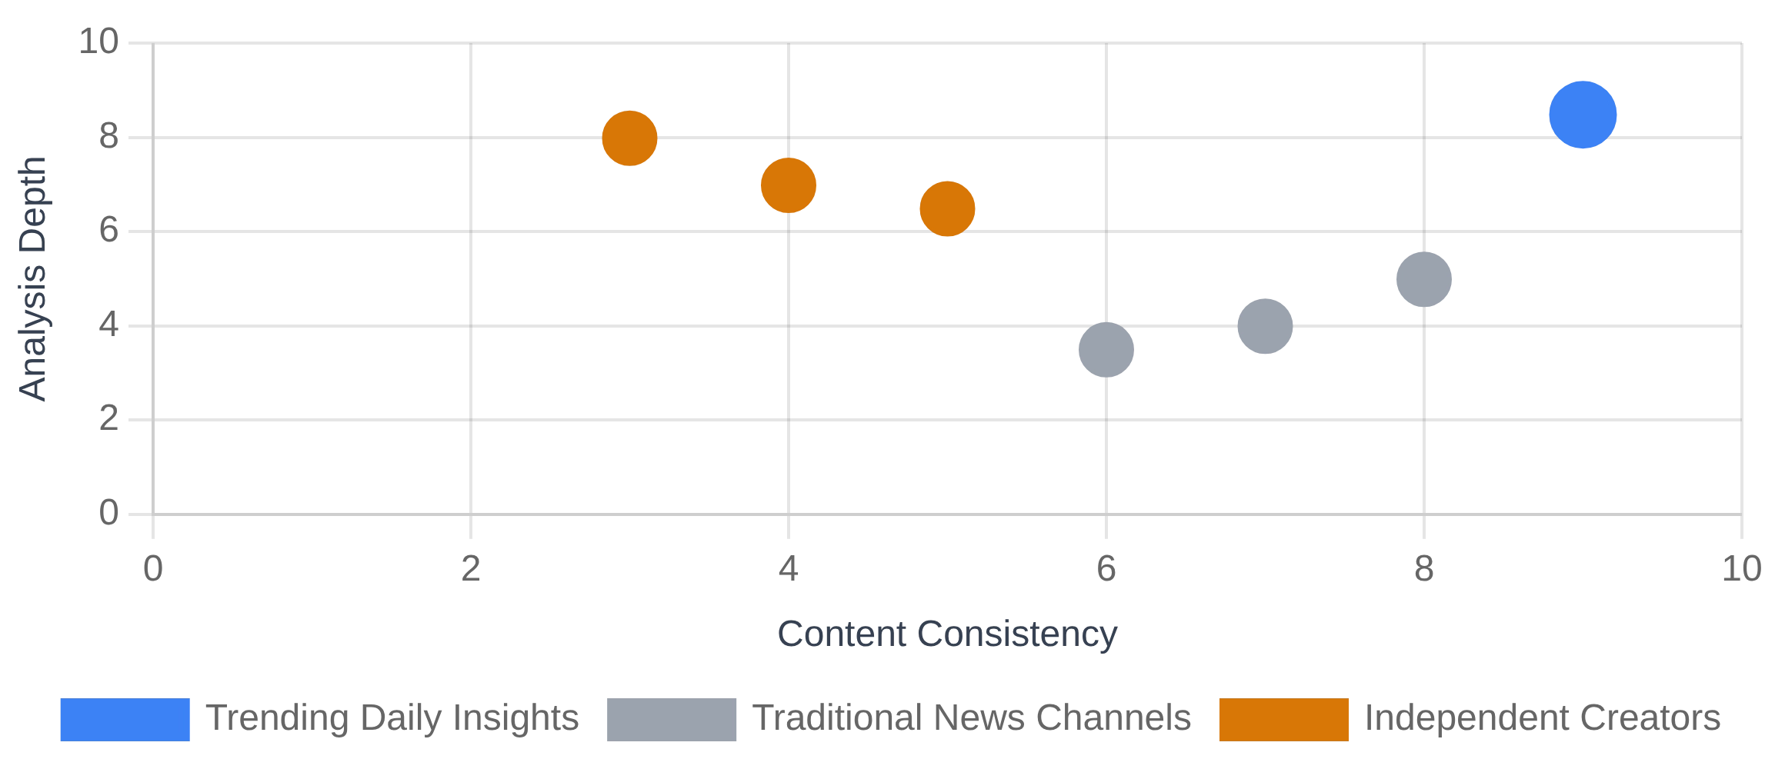









Competitive Advantage
Why Trending Daily Insights Outperforms Traditional Content Creators
Competitive Landscape Analysis
AI-Powered Consistency
Unlike human creators who face burnout and inconsistent schedules, our AI system delivers premium content every single day without fail, ensuring your sponsorship message reaches audiences consistently.
Data-Driven Optimization
Traditional creators rely on intuition; we use advanced analytics to continuously optimize sponsor placements, messaging, and timing for maximum engagement and conversion rates.
Premium Audience Quality
Feature
Trending Daily Insights
Traditional News
Independent Creators
Our geopolitical focus attracts high-income, educated professionals with significant purchasing power, unlike general news channels with broader but less valuable demographics.
Daily Content
Deep Analysis
Rapid Scaling Capability
While traditional creators are limited by human capacity, our AI system can rapidly scale content production and sponsor integrations to meet any campaign requirements.
Sponsor Integration

Slide 9


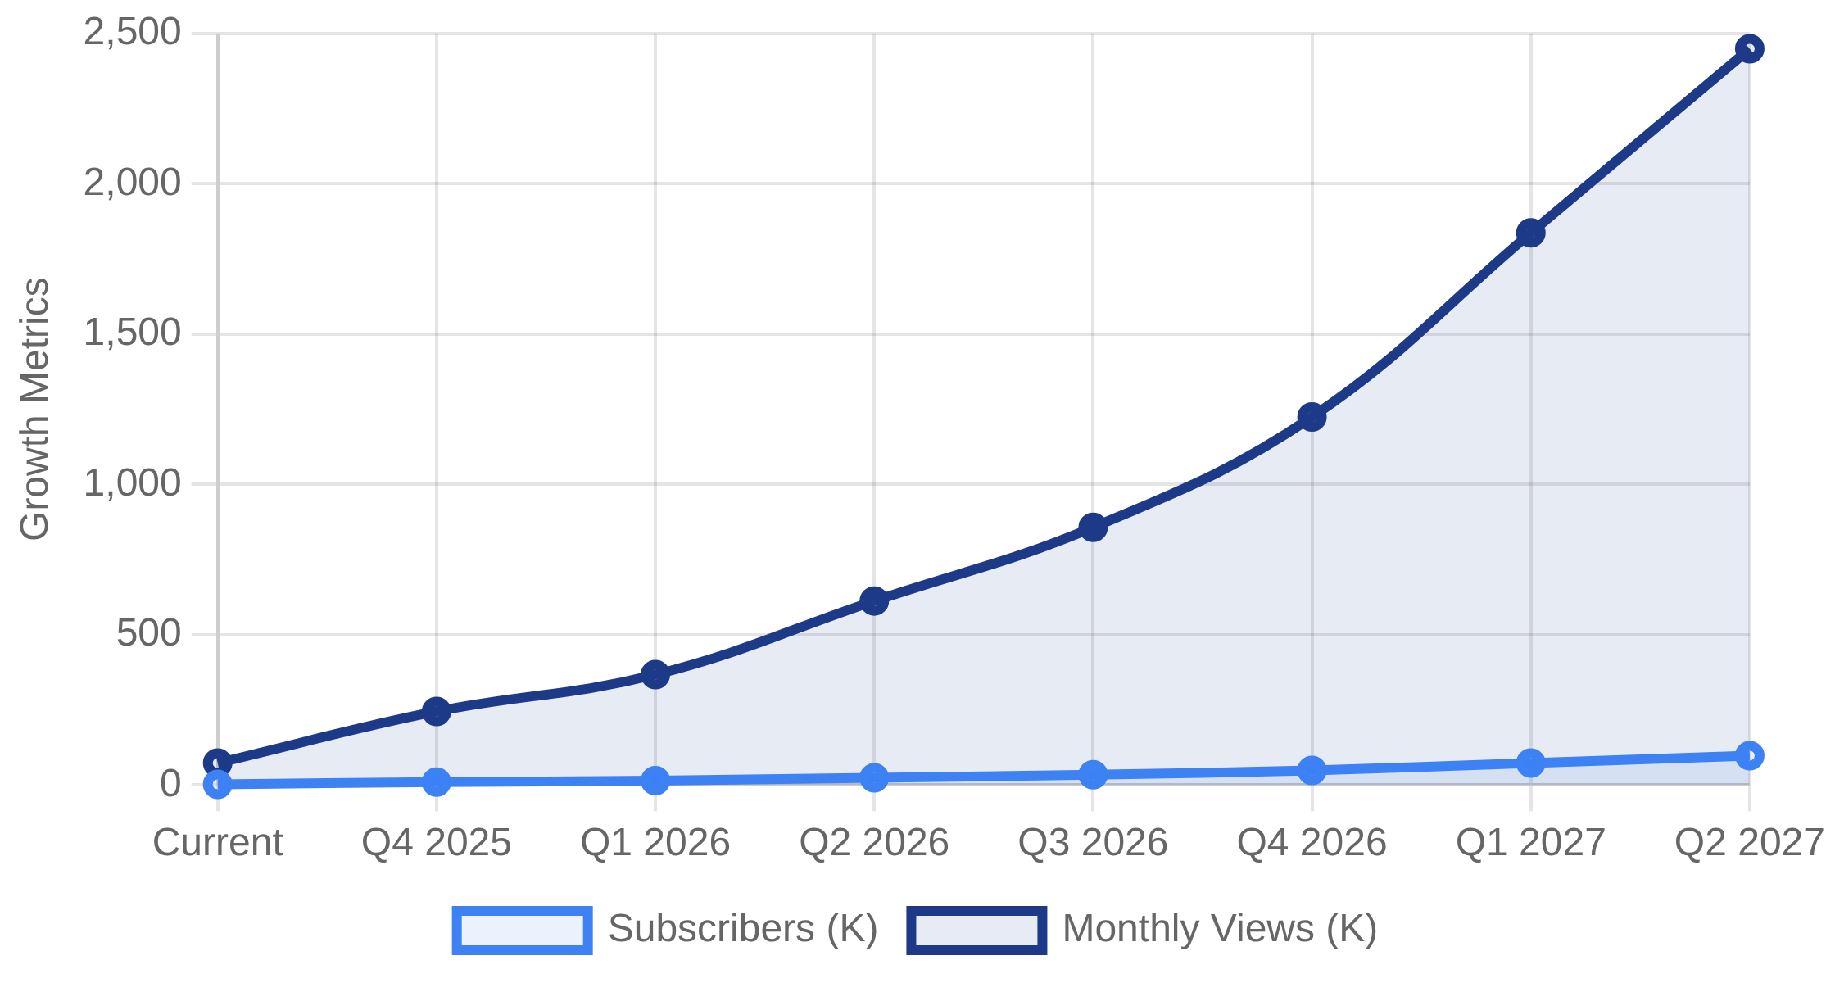



Growth Projections & Future Opportunities
Strategic Channel Expansion and Long-Term Partnership Value
Projected Growth Trajectory
Content Expansion
Expanding from daily briefings to include weekly deep dives, expert interviews, and special reports. Sponsors will gain additional integration opportunities across diverse content formats.
Regional Focus Series
Launching dedicated regional analysis series covering APAC, EMEA, and Americas. Perfect for sponsors targeting specific geographic markets with regional business interests.
Multi-Platform Expansion
Key Growth Milestones
Extending content to podcast and newsletter formats. Early sponsors will receive preferential placement and cross-platform integration at no additional cost.
Q4 2025
Q2 2026
Q4 2026
Q2 2027
10K Subscribers
25K Subscribers
50K Subscribers
100K Subscribers
Exclusive Partnership Opportunities
Category exclusivity and custom content creation for long-term partners. Lock in preferred rates now before premium tier pricing increases with audience growth.

Slide 10

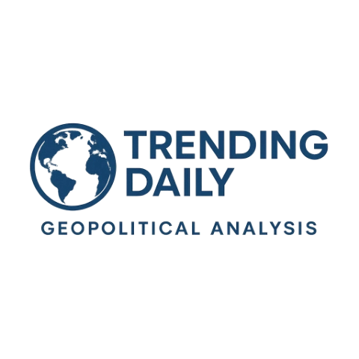



Partnership Opportunity
Join the premium sponsors reaching high-value decision makers through AI-powered geopolitical analysis
1
2
3
Schedule Consultation
Custom Proposal
Launch & Optimize
Receive a tailored sponsorship package designed to meet your specific KPIs and budget requirements
Begin your campaign with AI-optimized placement and receive real-time performance analytics
Book a 30-minute strategy call to discuss your specific marketing objectives and target audience
Schedule Your Consultation
sponsors@trendingdailyinsights.com
+1 (555) 123-4567
www.trendingdailyinsights.com/sponsors

